Slide 1
String Manipulation
TIP101
Notes:
🌟 Purpose: Welcome students and set the stage for learning about string manipulation in Python.
✅ What should I be doing?
Welcome students with energy and enthusiasm.
Highlight the importance of string manipulation as a key skill for problem-solving.
🎙️ What should I be saying?
Welcome to Week 3, Session 2 of TIP101! Today, we’re diving deeper into string manipulation, a powerful tool in Python that will help you solve a variety of coding challenges.
By the end of today, you’ll feel more confident working with strings, whether it’s reversing words, handling spaces, or applying transformations.
Remember, mastering string operations is essential for tackling problems efficiently and effectively.
🙌🏽 How should I engage students?
Ask: "What’s one thing you’ve found interesting or challenging about working with strings so far? Feel free to share in the chat."

Slide 2
1 | Welcome 👋🏽 | 10 minutes
2 | String Manipulation | 35 minutes
3 | BREAK | 5 minutes
4 | Collaborative Problem Solving | 60 minutes
5 | Wrap Up | 10 minutes
Notes:
🌟 Purpose: Provide a roadmap for the session and ensure clarity on the session structure.
✅ What should I be doing?
Walk through the session’s schedule, emphasizing the flow from instruction to practice.
🎙️ What should I be saying?
Here’s our agenda for today: We’ll begin by exploring string manipulation concepts and techniques. After a short break, we’ll move into collaborative problem-solving to apply what you’ve learned.
We’ll wrap up with reflections and some final reminders.
Our focus today is to make you comfortable with advanced string operations and help you understand their real-world applications.
🙌🏽 How should I engage students?
Pause and ask: "Does anyone have specific questions about today’s plan? Or is there anything you’d like to focus on during the string manipulation segment?"

Slide 3
Welcome! 👋🏽
10 minutes

Slide 4


Turn on your cameras
Fill out the entry ticket
Notes:
🌟 Purpose: Encourage visual engagement to foster connection during the session.
✅ What should I be doing?
Prompt students to enable their cameras and submit the entry ticket.
🎙️ What should I be saying?
Let’s kick off our session by turning on our cameras!
Also, don’t forget to fill out the entry ticket to help us organize breakout rooms later.
🙌🏽 How should I engage students?
Use humor or compliments: "Let’s see those smiles!"
Acknowledge and thank students who turn on their cameras.

Slide 5

Announcements & Reminders
Assessment Reminder:
Fix it garage sessions ended for now (onboarding specific to errors relating to VS Code, the course portal, Slack, etc.)
Study hall sessions will remain active !
Utilize VS Code debugging functionalities.
Notes:
🌟 Purpose: purpose
✅ What should I be doing?
Stuff
🎙️ What should I be saying?
Stuff
🙌🏽 How should I engage students?
stuff

Slide 6
5 minutes
🗣️Question:
You have been selected to give the next TED Talk on any topic of your choice. What are you choosing as your topic?
💬Answer:
Share your answer in the Zoom chat below. Multiple options are encouraged.

Slide 7
Students specifically calling each other out for their support.
Appreciated seeing more built in functions.
- Still some mixed feedback on pacing (too fast vs too slow).
-Jumping between content (dictionary->strings)
Notes:
🌟 Purpose: Share feedback from the previous session and highlight areas of success and improvement.
✅ What should I be doing?
Summarize feedback from the previous session's survey and present key takeaways.
🎙️ What should I be saying?
From your feedback, it seems many of you enjoyed [highlighted aspect]. One suggestion was [area for improvement]. We’ll work on that today.
🙌🏽 How should I engage students?
Ask: "Does anyone have additional feedback or suggestions?"

Slide 8
String Manipulation
35 minutes

Slide 9
String Basics (Reminder)
Strings are sequences of characters.
Common operations: concatenation, slicing, and formatting.
Useful methods: .lower(), .upper(), .split(),.replace()).
s = "Hello World"
print(s.lower()) # "hello world"
print(s[:5]) # "Hello"
Notes:
🌟 Purpose: Introduce key properties of strings and common operations.
✅ What should I be doing?
Use examples to explain string immutability, slicing, and formatting.
🎙️ What should I be saying?
Strings are sequences of characters, and they’re immutable, meaning you can’t change them directly. Think of them like sentences written in pen—you can rewrite them, but you can’t erase specific parts.
Some common operations include concatenation, slicing, and using methods like .lower() and .split(). For example, in the string s = 'Hello World', calling s.lower() will return 'hello world'.
Let’s try slicing—what do you think s[:5] will return?
🙌🏽 How should I engage students?
Ask: "Can someone explain why slicing is useful? How might you use it in a coding challenge?"

Slide 10
String Formatting (two ways)
String formatting allows you to create a string “template” that can dynamically fill in placeholders in the string. For example, something like this string which will contain user specific data:
“{userName} has signed in at {currentTime}.”
userName = "Cory2026"
currentTime = “March 10th, 8:15pm”
print(f“{userName} has signed in at {currentTime}.”)
Notes:
🌟 Purpose: Introduce key properties of strings and common operations.
✅ What should I be doing?
Use examples to explain string immutability, slicing, and formatting.
🎙️ What should I be saying?
Strings are sequences of characters, and they’re immutable, meaning you can’t change them directly. Think of them like sentences written in pen—you can rewrite them, but you can’t erase specific parts.
Some common operations include concatenation, slicing, and using methods like .lower() and .split(). For example, in the string s = 'Hello World', calling s.lower() will return 'hello world'.
Let’s try slicing—what do you think s[:5] will return?
🙌🏽 How should I engage students?
Ask: "Can someone explain why slicing is useful? How might you use it in a coding challenge?"

Slide 11
String Formatting (two ways)
String formatting allows you to create a string “template” that can dynamically fill in placeholders in the string. For example, something like this string which will contain user specific data:
“{userName} has signed in at {currentTime}.”
userName = "Cory2026"
currentTime = “March 10th, 8:15pm”
print(“{} has signed in at {}.”.format(userName, currentTime))
Notes:
🌟 Purpose: Introduce key properties of strings and common operations.
✅ What should I be doing?
Use examples to explain string immutability, slicing, and formatting.
🎙️ What should I be saying?
Strings are sequences of characters, and they’re immutable, meaning you can’t change them directly. Think of them like sentences written in pen—you can rewrite them, but you can’t erase specific parts.
Some common operations include concatenation, slicing, and using methods like .lower() and .split(). For example, in the string s = 'Hello World', calling s.lower() will return 'hello world'.
Let’s try slicing—what do you think s[:5] will return?
🙌🏽 How should I engage students?
Ask: "Can someone explain why slicing is useful? How might you use it in a coding challenge?"

Slide 12
Given a string s containing words separated by spaces, reverse the order of the words. Remove extra spaces and ensure that words are separated by a single space in the output.
def reverse_words(s):
pass
Input: s = " the sky is blue "
Output: "blue is sky the"
Notes:
🌟 Purpose: Demonstrate solving a problem using the UMPIRE strategy, emphasizing practical string manipulation techniques, debugging, and student engagement.
✅ What should I be doing?
Walk students through the problem of reversing words in a string while demonstrating the UMPIRE strategy.
Show how to approach real-world applications of string manipulation using Python.
Normalize mistakes by intentionally introducing errors and debugging them.
🎙️ What should I be saying?
1. Understand the Problem
"Let’s start with the first step of UMPIRE—Understand. The problem asks us to reverse the order of words in a string while ensuring that there are no extra spaces and that words are separated by a single space."
"For example, the input string ' the sky is blue ' should return 'blue is sky the'. Notice how the leading, trailing, and extra spaces are removed in the output."
"Edge cases include empty strings, strings with only spaces, or single-word inputs."
Ask Students: "What other edge cases can you think of? For example, what happens if the input contains special characters or numbers?"
2. Plan the Solution
"Next, let’s plan our solution. Here’s the step-by-step approach:
Use the .strip() method to remove leading and trailing spaces.
Split the string into a list of words using the .split() method, which automatically handles multiple spaces.
Reverse the list of words.
Join the words back into a single string using ' '.join()."
"This approach ensures that we handle extra spaces and reverse the word order efficiently."
Ask Students: "Does this plan make sense? Is there another way we could approach this problem?"
3. Implement the Solution
"Now, let’s implement the solution step by step. I’ll start by defining the function and writing the code based on our plan."
Write the code: def reverse_words(s):
# Step 1: Remove leading and trailing spaces
s = s.strip()
# Step 2: Split the string into words
words = s.split()
# Step 3: Reverse the list of words
reversed_words = words[::-1]
# Step 4: Join the reversed words into a single string
return ' '.join(reversed_words)
Normalize Mistakes: Introduce a small error, such as forgetting to use .strip(), and debug it.
Example: Skip .strip() and run the code.
"Hmm, why is the output not as expected? Let’s debug by printing the intermediate results at each step."
Fix the code and explain how .strip() resolves the issue.
4. Test the Solution
"Let’s test the function with some examples. First, we’ll try the input ' the sky is blue '. The expected output is 'blue is sky the'. Let’s run it and see."
"Now let’s test edge cases like an empty string (''), a string with only spaces (' '), and a single word ('hello')."
Ask Students: "What other test cases should we consider? For example, what about strings with special characters or numbers?"
5. Review and Reflect
"We used the UMPIRE strategy to solve this problem step by step. String methods like .strip(), .split(), and .join() made this task straightforward."
"This problem shows how important it is to break down complex problems into smaller, manageable steps."
Ask Students: "Why do you think splitting the string into words first makes the problem easier to solve? Can you think of other problems where this approach might be useful?"
🙌🏽 How should I engage students?
Prompt predictions: "What do you think the output will be before we run this?"
Encourage debugging participation: "What’s one way we could figure out what went wrong here?"
Validate contributions: "Great suggestion! That’s exactly why splitting the string first simplifies things."

Slide 13
Given a string s containing words separated by spaces, reverse the order of the words. Remove extra spaces and ensure that words are separated by a single space in the output.
def reverse_words(s):
pass
Challenge!
Sometimes in interviews, you will be given a specific restriction or requirement.
What if the interviewer says that you may not use the .reverse() method?
Input: s = " the sky is blue "
Output: "blue is sky the"
Notes:
🌟 Purpose: Demonstrate solving a problem using the UMPIRE strategy, emphasizing practical string manipulation techniques, debugging, and student engagement.
✅ What should I be doing?
Walk students through the problem of reversing words in a string while demonstrating the UMPIRE strategy.
Show how to approach real-world applications of string manipulation using Python.
Normalize mistakes by intentionally introducing errors and debugging them.
🎙️ What should I be saying?
1. Understand the Problem
"Let’s start with the first step of UMPIRE—Understand. The problem asks us to reverse the order of words in a string while ensuring that there are no extra spaces and that words are separated by a single space."
"For example, the input string ' the sky is blue ' should return 'blue is sky the'. Notice how the leading, trailing, and extra spaces are removed in the output."
"Edge cases include empty strings, strings with only spaces, or single-word inputs."
Ask Students: "What other edge cases can you think of? For example, what happens if the input contains special characters or numbers?"
2. Plan the Solution
"Next, let’s plan our solution. Here’s the step-by-step approach:
Use the .strip() method to remove leading and trailing spaces.
Split the string into a list of words using the .split() method, which automatically handles multiple spaces.
Reverse the list of words.
Join the words back into a single string using ' '.join()."
"This approach ensures that we handle extra spaces and reverse the word order efficiently."
Ask Students: "Does this plan make sense? Is there another way we could approach this problem?"
3. Implement the Solution
"Now, let’s implement the solution step by step. I’ll start by defining the function and writing the code based on our plan."
Write the code: def reverse_words(s):
# Step 1: Remove leading and trailing spaces
s = s.strip()
# Step 2: Split the string into words
words = s.split()
# Step 3: Reverse the list of words
reversed_words = words[::-1]
# Step 4: Join the reversed words into a single string
return ' '.join(reversed_words)
Normalize Mistakes: Introduce a small error, such as forgetting to use .strip(), and debug it.
Example: Skip .strip() and run the code.
"Hmm, why is the output not as expected? Let’s debug by printing the intermediate results at each step."
Fix the code and explain how .strip() resolves the issue.
4. Test the Solution
"Let’s test the function with some examples. First, we’ll try the input ' the sky is blue '. The expected output is 'blue is sky the'. Let’s run it and see."
"Now let’s test edge cases like an empty string (''), a string with only spaces (' '), and a single word ('hello')."
Ask Students: "What other test cases should we consider? For example, what about strings with special characters or numbers?"
5. Review and Reflect
"We used the UMPIRE strategy to solve this problem step by step. String methods like .strip(), .split(), and .join() made this task straightforward."
"This problem shows how important it is to break down complex problems into smaller, manageable steps."
Ask Students: "Why do you think splitting the string into words first makes the problem easier to solve? Can you think of other problems where this approach might be useful?"
🙌🏽 How should I engage students?
Prompt predictions: "What do you think the output will be before we run this?"
Encourage debugging participation: "What’s one way we could figure out what went wrong here?"
Validate contributions: "Great suggestion! That’s exactly why splitting the string first simplifies things."

Slide 14

Break Time!
Take 5 mins to step away from the computer. Feel free to turn off your camera and return promptly after 5 mins.
Notes:
🌟 Purpose: Provide a short break to refresh and re-energize.
✅ What should I be doing?
Announce the break and remind students to return on time.
Play the countdown timer video (be sure to share sound).
🎙️ What should I be saying?
Let’s take 5 minutes to step away from the screen. Be sure to return promptly.

Slide 15
Collaborative Problem Solving
60 minutes

Slide 16
60 minutes
🏃🏽 Navigate to your breakout room.
👋🏽 Introduce yourselves!
🧑🏽‍💻 Work on the problems for your selected unit.

Slide 17
Wrap Up
10 minutes

Slide 18
Notes:
🌟 Purpose: End the session on a positive note.
✅ What should I be doing?
Prompt students to share their reflections in the chat.
🎙️ What should I be saying?
Let’s celebrate your wins. Share one good thing you learned or accomplished today!
🙌🏽 How should I engage students?
Read a few responses aloud and celebrate with enthusiasm.

Slide 19

EARLY-COURSE SURVEY
Open the email you enrolled in CodePath with
Locate the message from support@codepath.org titled:
[Course Code] Early Course Survey - Please Complete
3. Open your unique survey link
4. Answer each question completely and honestly
5. Celebrate: You’re helping CodePath courses improve!
Notes:
How to locate email:
Open Email (email student enrolled in CodePath with)
Email sent by support@codepath.org
If a student cannot locate the email, they should message in the Zoom chat, and Ops / Floor Leads will assist in providing their personal survey link.

Slide 20

Final Reminders
Finish the problem sets for additional practice
Take the weekly HackerRank assessment by Sunday @ midnight
Visit a Study Hall Session to deepen your understanding, work through challenges, and connect with course material alongside your peers!
Remember to check out the Codepath AI Tutor Bot and earn an absence back! ➡️
Notes:
🌟 Purpose: Reinforce key tasks and deadlines.
✅ What should I be doing?
Summarize next steps and encourage continued engagement.
🎙️ What should I be saying?
Don’t forget to complete the problem sets and take the HackerRank assessment by Sunday!
🙌🏽 How should I engage students?
Encourage students to ask any lingering questions before signing off.

Slide 21
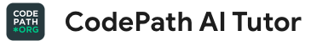
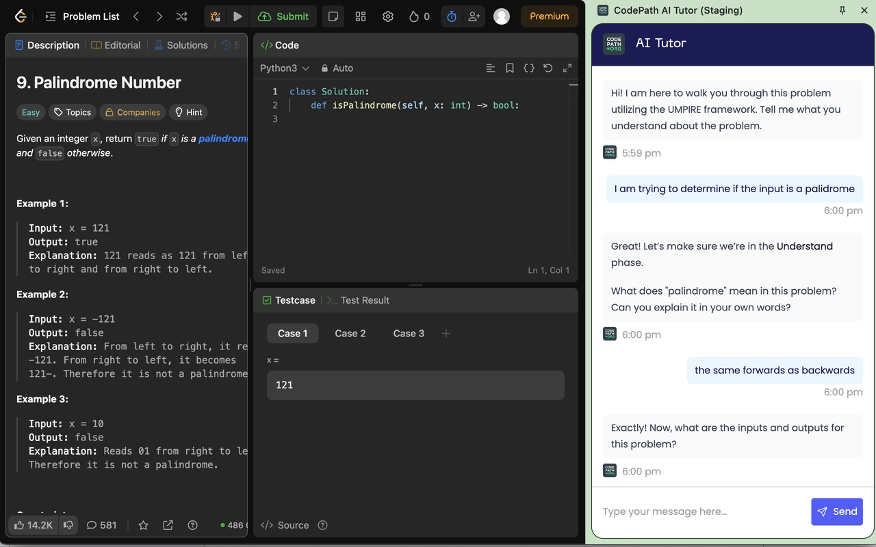

How do I get the most out of this course?
Build your skills with support! Take the following steps:
Install the AI Tutor on chrome: https://go.codepath.org/tiptutor
Solve 2 LeetCode problems on 2 different days
Once you’ve taken the steps above, unlock a new opportunity!
+1 absence back for completion(one-time offer)
Take a look at the FAQ if you have any questions
Notes:
🌟 Purpose: Show the new CodePath AI Tutor.
✅ What should I be doing?
Encourage the use of the new AI Tutor: https://go.codepath.org/tiptutor
Specifically for use with LeetCode problems
🎙️ What should I be saying?
It’s common to get stuck on a difficult problem when practicing independently. Try using the AI Tutor as a way to get unstuck, guiding you through the UMPIRE method for the problem.
🙌🏽 How should I engage students?
Complement your additional practice with the support and guidance from the AI Tutor.

